Slide 1
Unsung Hero of the Cloud Native Revolution
Container Linux Then and Now
KubeCon NA 2022
Vincent Batts

Slide 2
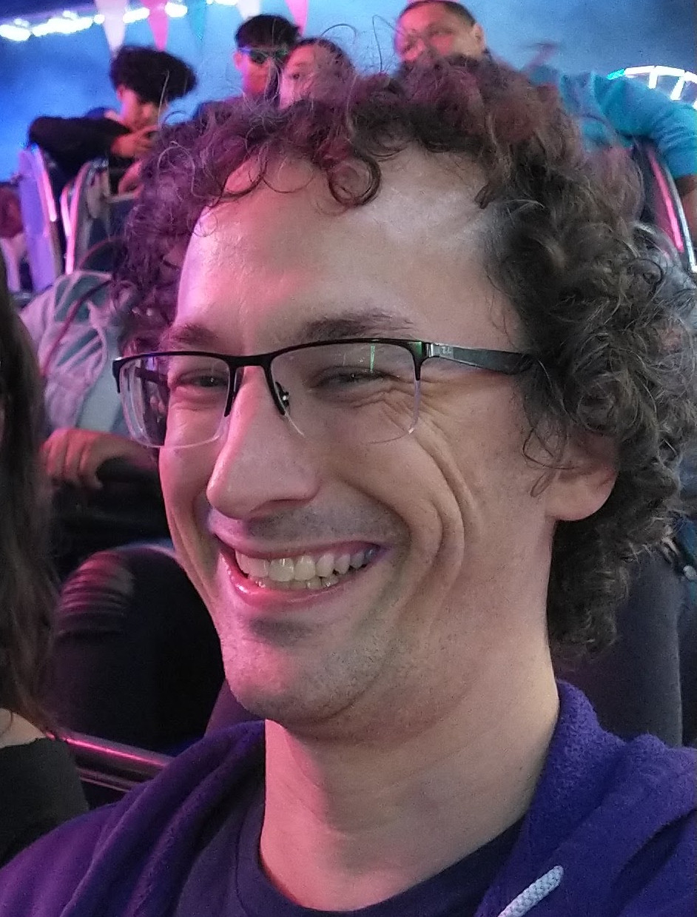
Howdy 👋
$> whoami
vbatts
$> id -Gn
devel msft flatcar kinvolk redhat oci appc docker golang slackware ruby

Slide 3
Container Linux!
🐝
Cloud Native!
Minimal Footprint!
IKEA vs. Artisanal
Atomic updates!
🐝
🐝
🐝
🐝

Slide 4
But, what is “a Linux”?
Well, actually it’s GNU/Linux …
What makes it “what people and tooling expect?”

Slide 5

Is this a Linux?
syscalls, ioctls, fcntls?
libc?
Kernel CONFIG_’s?
Config (/etc or CM tooling)
Early boot provisioning? (ignition or cloud-init) ((secrets??))
Host services? (unit files and dbus?) 😩
NVR of software

Slide 6
A brief history
Read only?
  Knoppix (2000) – a first of the “live” from CD Linuxes
Minimal?
  Damn Small Linux (2005) ~50Mb
Isolation?
  mountns (2002)
“Userspace”
  An ongoing swarm of iteration and improvements and sprawl

Slide 7
A brief history
2008 LXC is launched
2013 CoreOS releases the first “Container Linux”
  based on the ChromiumOS created for Chromebooks
  Gentoo is the upstream
2013 dotCloud releases Docker
2014 Kubernetes is launched
Since then: Atomic; Flatcar; Talos; FedoraCoreOS (RHEL and CentOS too); bottlerocket; k3os; openSUSE Micro; LinuxKit; gardenlinux; and I’m sure others ...
(other history talks at github.com/vbatts/talks)

Slide 8
Common Challenges
Do you know when something becomes artisanal?
Package management
  Trust
  Proofs
  Determinism (scriptlets; ordering; file system API’s)
Who says a a reboot is needed? How?
“Let’s innovate and think about how to migrate later!”
“If folks should use my approach if they want things to work together!”

Slide 9
Common Challenges
“is this change/rollout deterministic?”
When you deploy “A Kubernetes”, that is not a definitive, standard thing.
  Every extension, runtime, plugin, and even config field can have implicit and explicit variations needed.

Slide 10
Don’t get me wrong
Packagers and Upstreams are critical
The kernel and OS [interfaces] you use matter
You end users and admins/ops/architects actively don’t care about your epiphany if you’ve made their life harder for no reason
Everyone wants their precious to be the winner …

Slide 11
Where are we now?
It depends...
Compartmentalizing our frustration 🥺
We’ve all suffered these pains, individually and collectively
Renewed interest in defining and establishing the common OS interfaces
  #kube-operating-systems-dev (k8s slack)
  (beyond kubelet, CRI, CNI, CSI, etc.)
What is your use-case? Let that drive you, not a marketing pitch

Slide 12
💚 y’all
Find me online
  Then we can talk like humans
    Let’s work together

